Slide 1
Classification: Internal
IPDO
Optical images for Size Distribution of Swallowed Resin
ACT LAB

Slide 2
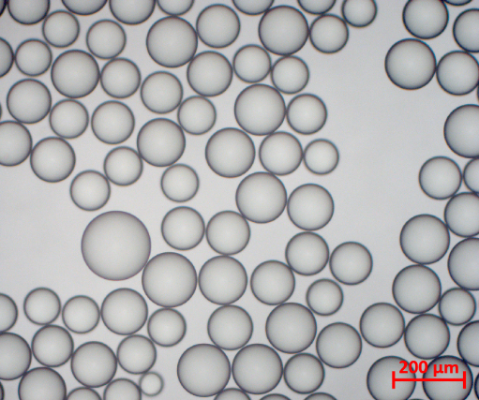
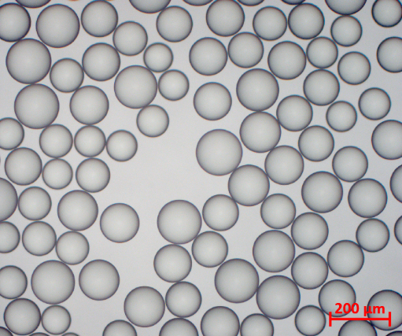
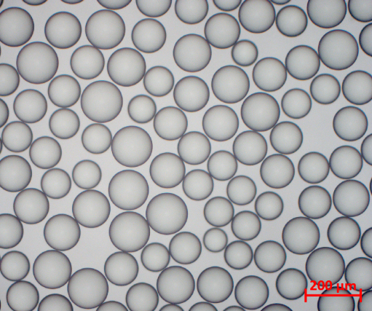
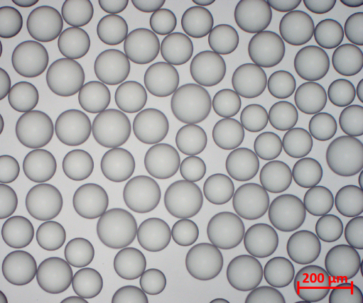
Classification: Internal
* Problem statement is these are the swallowed resin, contract of inside and out side are same. Having problem to do automatic image analysis to get size distribution data
** Two batches data with 5 different time points are uploaded

